Slide 1
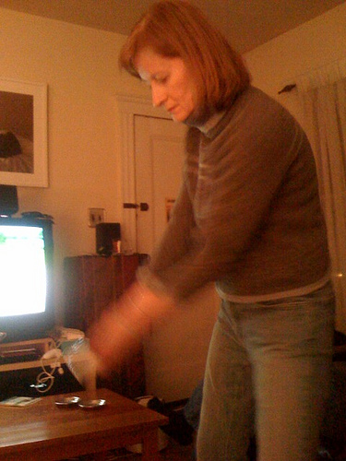
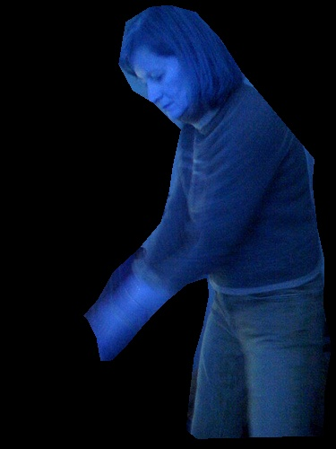
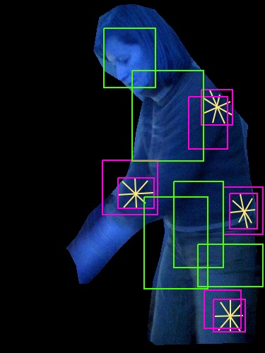
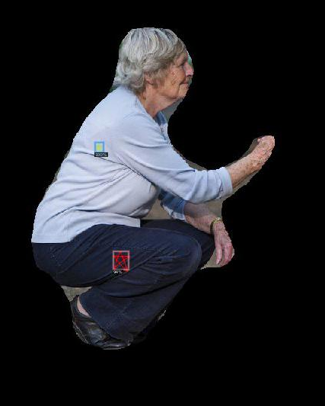
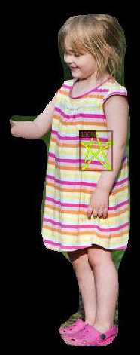
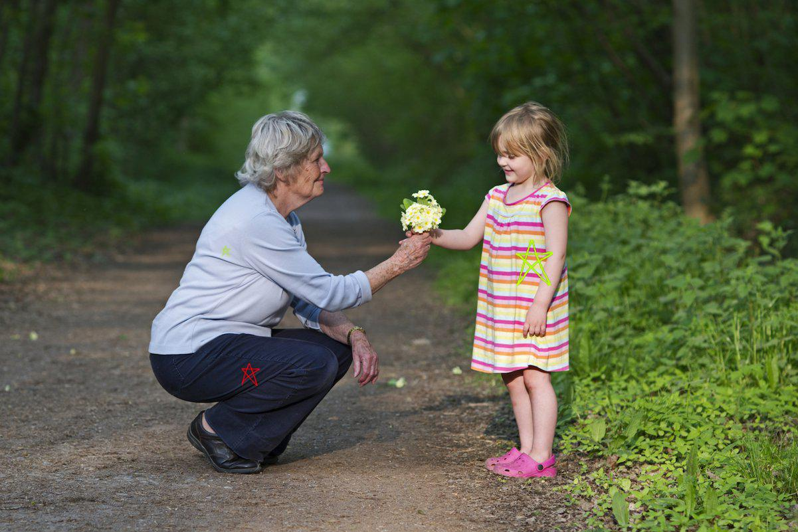
Training
Green – Normal boxes
Red – Abnormal boxes
Mask-
RCNN
Put marks
Normal / Abnormal
Faster -
RCNN
model
Box coordinates
Testing
Person mask
Mask-
RCNN
Faster -
RCNN
model
Full Model

